Slide 1
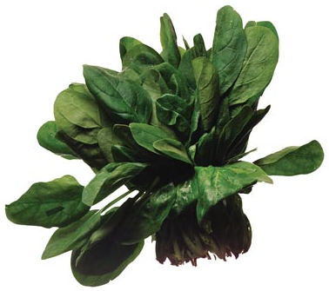
SPINACH
A VIRTUAL FIELD TRIP

Slide 2
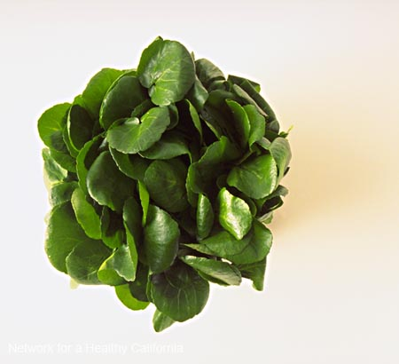
What About Spinach?
Spinach is an edible flowering plant which can grow up to 30 cm!
It is considered one of the world’s healthiest vegetables due to its nutrient richness.
Spinach is extremely rich in antioxidants which is why it is called a “super food!”

Slide 3
Full of Nutritional Goodies
An excellent source of vitamin A, vitamin K
A good source of vitamin C
A 180g serving of spinach has more iron than a 170g hamburger patty!
4.42mg of iron 6.43mg of iron

Slide 4
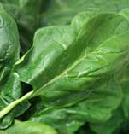


All in the Family
Spinach belongs in the goosefoot family.
Beets and Swiss chard are relatives.
Goosefoot Family
Spinach Beets Swiss chard

Slide 5
Where Does Spinach Come From?
Spinach was a native plant of Persia (modern day Iran)
It was introduced to China in the 7th century
Spinach made its way to Europe in the 12th century
Spinach then came to the U.S. in 1806

Slide 6
Growing the Greens
Worldwide, the U.S. is the second largest spinach producer.
We account for a small 3% of the world’s production.
The leading spinach producer is China – they supply 85% of the world’s spinach!

Slide 7
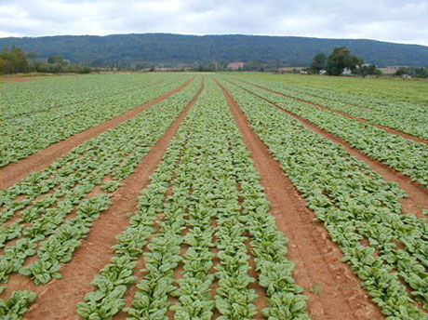
Growing the Greens…
The U.S.’s #1 grower/supplier of Spinach today is….
CALIFORNIA!
California accounts for 75% of the nation’s spinach.

Slide 8

Famous Spinach
Popeye, a cartoon character, had superhuman strength!
Can you guess what gave him this strength?
SPINACH!

Slide 9



Spinach Festivals
People love spinach so much they even have festivals all around the country!

Slide 10

How are you going to eat your spinach?

Slide 11

Thanks for taking the virtual field trip!
Until next time…
Created by Kelley Tenny, NBCT – Health Education

Slide 12
Resources
Harvest of the Month
http://www.harvestofthemonth.com
Alma Spinach festival
http://www.almaspinachfestival.com/
Naturally-Healthy-Eating.com
http://www.naturally-healthy-eating.com/benefits-of-spinach.html
The World’s Healthiest Foods
http://www.whfoods.com/genpage.php?tname=foodspice&dbid=43

